Slide 1
Cerebral Circulation
Dr. Tania Warnakulasuriya
Department of Physiology

Slide 2
Cerebral Circulation
~15% of cardiac output goes to the brain
A constant blood supply is needed as the brain rely on oxidative metabolism
Organ | Blood flow |  | % of CO | % of O₂ consumption
 | mL/min | mL/100g/min
Brain | 750 | 54 | 13.9 | 18.4
Heart | 250 | 84 | 4.7 | 11.6
Kidney | 1260 | 420 | 23.3 | 7.2
Liver | 1500 | 57.7 | 27.8 | 20.4
Skeletal muscle | 840 | 2.7 | 15.6 | 20

Slide 3
Cerebral circulation
Arterial circulation
2 pairs of arteries form the circle of Willis
Internal carotid
Vertebral arteries
Provides collateral circulation
Cerebral arteries do not have cross over of flow.
Occlusion of a cerebral artery results in ischemia.

Slide 4
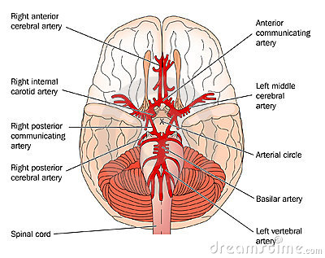
Circle of Willis

Slide 5
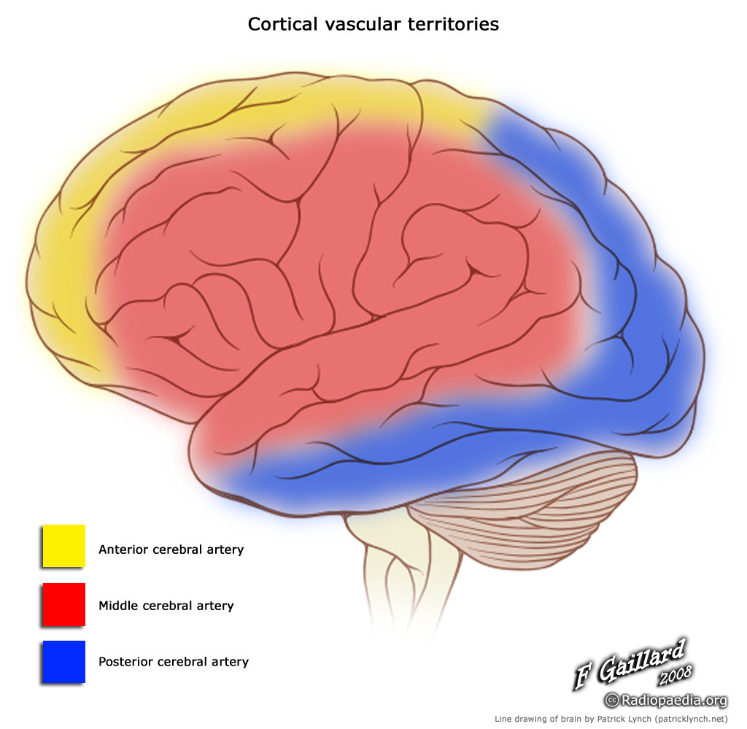
Blood supply to the cerebral hemisphere

Slide 6
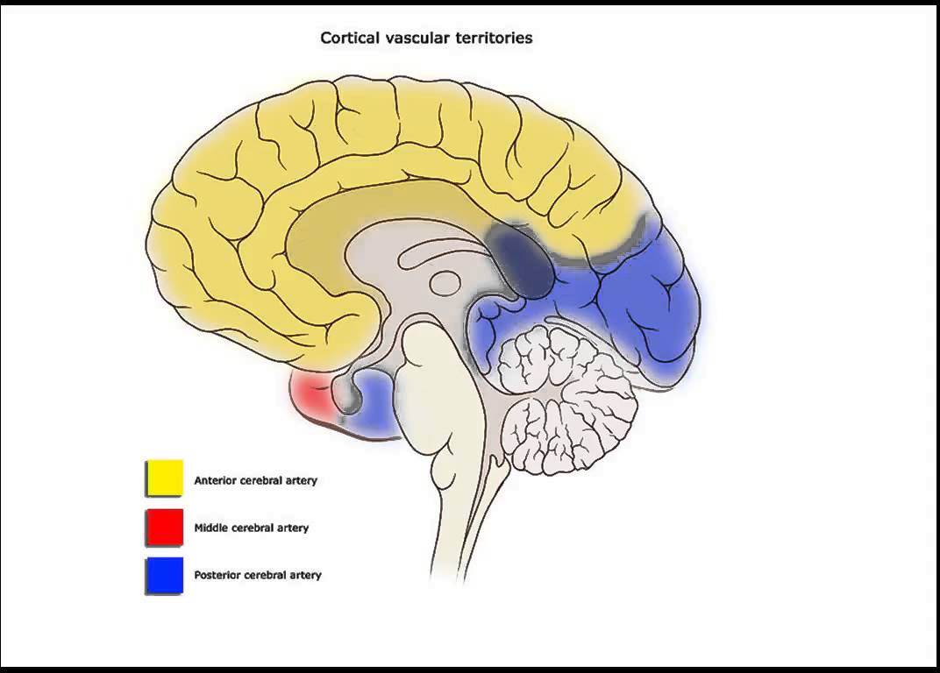

Slide 7
Cerebral circulation
Venous drainage
Via Dural sinuses and deep cerebral veins
Special feature is that the veins are valve-less

Slide 8
Cerebral circulation
Innervation of cerebral blood vessels
Post ganglionic sympathetic nerves – norepinephrine
Cholinergic neurons
Sensory nerves
Cerebral blood vessels are pain sensitive.

Slide 9
Cerebral circulation Ohm’s law
Flow= Difference in inflow and outflow of pressure
Resistance

Slide 10
Cerebral circulation
Venous pressure in the brain is normally low.(2-5 mmHg)
Venous pressure is mainly influenced by intra cranial pressure.
Cerebral blood flow= MAP-ICP
Resistance

Slide 11
Cerebral circulation
Autoregulation
Is the ability of the brain to maintain relatively constant blood flow despite changes in perfusion pressure.
Autoregulation is maintained between the MAP of 65-140 mmHg.
Out of the range of autoregulation cerebral blood flow is dependent on mean arterial pressure in a linear fashion.

Slide 12
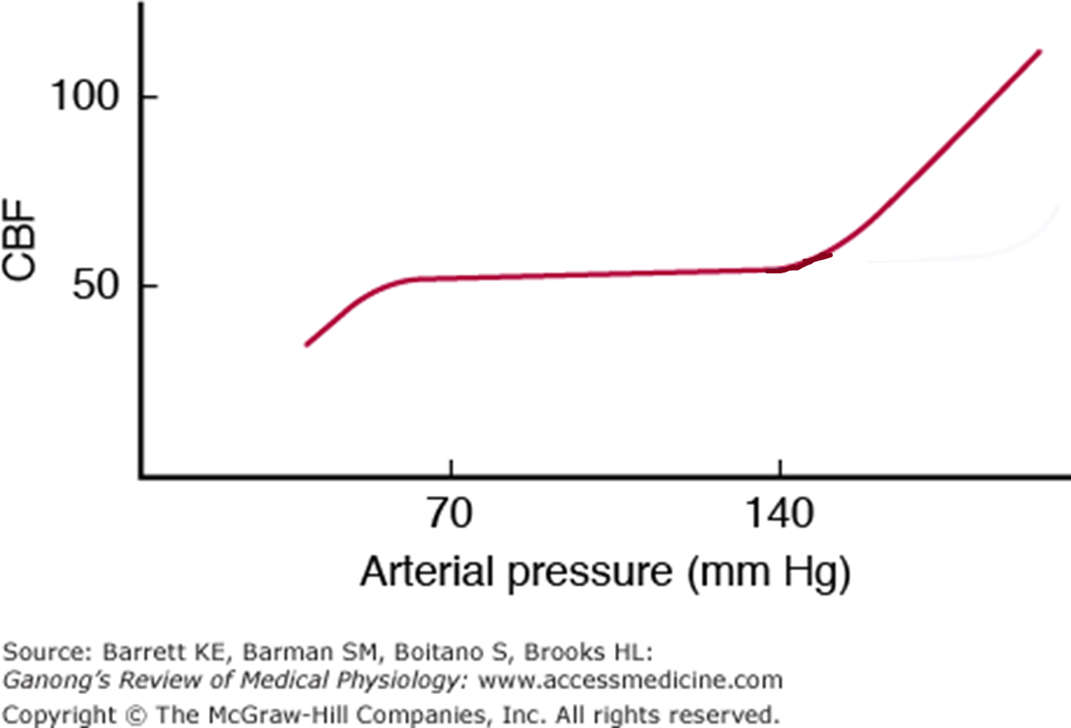
Cerebral Autoregulation

Slide 13
Cerebral circulation
In resting adult
Grey matter has an average blood flow of 69ml/100g/min
White matter has an average blood flow of 28ml/100g/min
When awake the highest blood flow is to the premotor and frontal areas.

Slide 14
Cerebral circulation
Factors affecting cerebral autoregulation
Vasomotor and sensory nerves.
Intra Cranial Pressure (ICP).
Local constriction and dilation of cerebral vessels.
Mean arterial and mean venous pressure at brain level.
Viscosity of blood.

Slide 15
Cerebral circulation
Role of vasomotor nerves
Large cerebral vessels are innervated by sympathetic and parasympathetic nerves
Noradrenergic discharge occurs when blood pressure is markedly elevated
Reduces the resulting passive increase in blood flow
( plateau part of pressure flow curve shift to rhight)

Slide 16
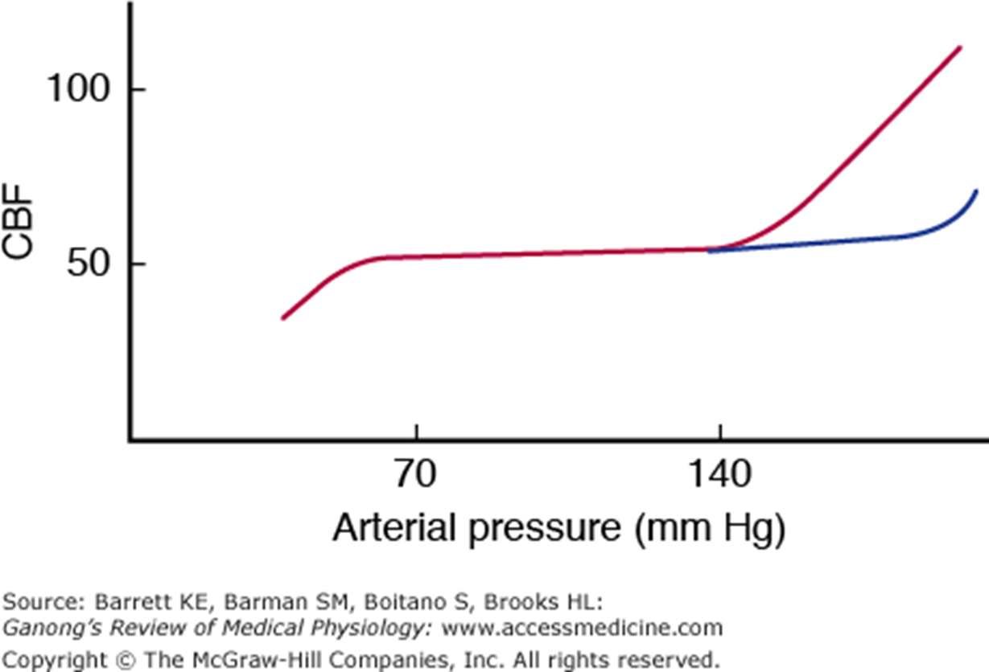
Sympathetic stimulation reduces the resulting passive increase in blood flow

Slide 17
Cerebral circulation
Affects of ICP
Brain is encased in a rigid bony structure – the skull
Brain, CSF and blood are incompressible.
Increase in volume in the skull increases the ICP.
Increased ICP reduce cerebral blood flow.
Reduced ICP increase cerebral blood flow.

Slide 18
Cerebral circulation
Cushing reflex
Increase in ICP.
Compress blood vessels.
Reduces blood supply to vasomotor area.
Result in local hypoxia and hypercapnoea.
Discharge of vasomotor area increase.
Increase systemic blood pressure.
Elevation of blood pressure result in baroreceptor discharge.
Bradycardia ensues.

Slide 19
Cerebral circulation
Local control of cerebral blood flow is mainly affected by
Metabolic control
CO₂ concentration
H⁺ concentration
O₂ concentration
Myogenic response

Slide 20
Cerebral Circulation
CO₂
Elevated CO₂ - vasodilation due to elevated H⁺ in the extracellular space
Reduced CO₂ - vasoconstriction
This is used when there is cerebral oedema where hyperventilation causes CO₂ washout and reduces the oedema due to less cerebral blood flow.

Slide 21
Cerebral Circulation
O₂
Hypoxia is a potent vasodilator
Reduced O₂ causes ATP depended K channels to open.
Hyperpolarization of smooth muscle cells.
Relaxation of smooth muscle.
Increase NO and adenosine

Slide 22
Cerebral Circulation
Regulation of cerebrovascular tone by myogenic response( Bayliss effect)
Occur in the face of changing systemic pressure.
Smooth muscle intrinsic contraction in response to elevated systemic pressure and dilation in response to reduced systemic pressure.

Slide 23
Bayliss effect
Stretch of artery
Vascular smooth muscle cell Depolarization
Ca²⁺ in to the smooth muscle cells
Arterial Constriction

Slide 24
Cerebral circulation
Depending on the body part active, the blood flow increase to the corresponding part of the brain.
High metabolic demands of neural tissue require coordination between neuronal activity and blood flow in the brain.

Slide 25
Cerebral circulation
Measuring blood flow to different parts of the brain
Positron emission tomography
Functional magnetic resonance imaging
Diffusion weighted MRI

Slide 26
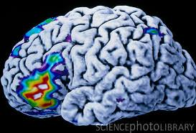
PET of a person during speech

Slide 27
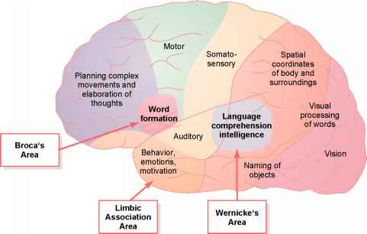
Association cortex

Slide 28
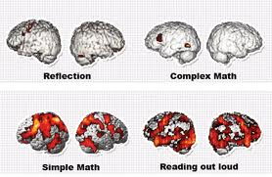
PET during various activities

Slide 29
Cerebral circulation
Brain metabolism
Approximately 20% of total body resting oxygen consumption happens in the brain.
Brain is extremely sensitive to hypoxia.
Glucose is the ultimate energy source.
During prolong starvation brain can use lipid or amino-acid for energy.
Either prolong hypoxia or hypoglycemia will cause severe brain damage.

Slide 30
Blood brain barrier
Present in the endothelium through out the brain.
Apical tight junctions of endothelial cells control ion, protein movement across the endothelium.

Slide 31
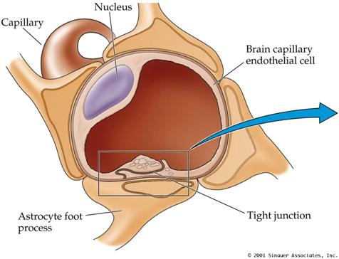
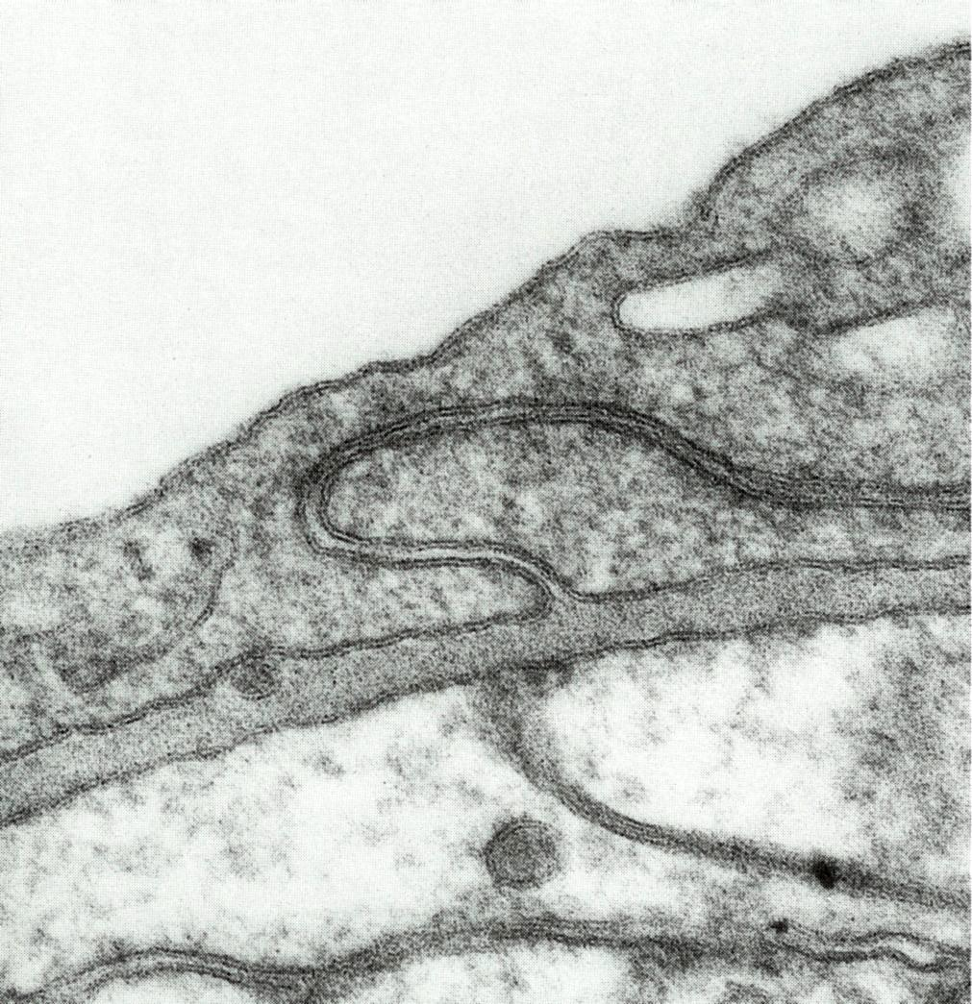
BBB

Slide 32
BBB
O_{2 ,} CO₂ and lipophilic substances are transported freely.
Glucose, galactose, Amino acids and Nucleotides are transported by facilitated diffusion.
Receptor mediated transport and active efflux transport has a role .

Slide 33
BBB
All proteins, polypeptides and substances bound to proteins do not cross the BBB freely.
Water movement into the brain by hydrostatic pressure is immediately apposed by the osmotic pressure gradient in the vascular lumen.

Slide 34
SUMMARY
Precise regulation of blood flow to the brain is essential to maintain life.
Autoregulation is maintained between the MAP of 65-140 mmHg.
Vasomotor and sensory nerves, Intra Cranial Pressure (ICP),Local control of cerebral vessels play an important part in cerebral auto regulation.
Depending on the part of the brain that is active there is marked variation in flow of blood

Slide 35
Q
Describe the changes that would affect auto regulation of the cerebral circulation in the following instances
1. sympathetic stimulation
2. ingestion of vasodilator angiotensin converting enzyme inhibitor.

